Slide 1

Banana ChAIser
Object Detection Driven Car

Slide 2

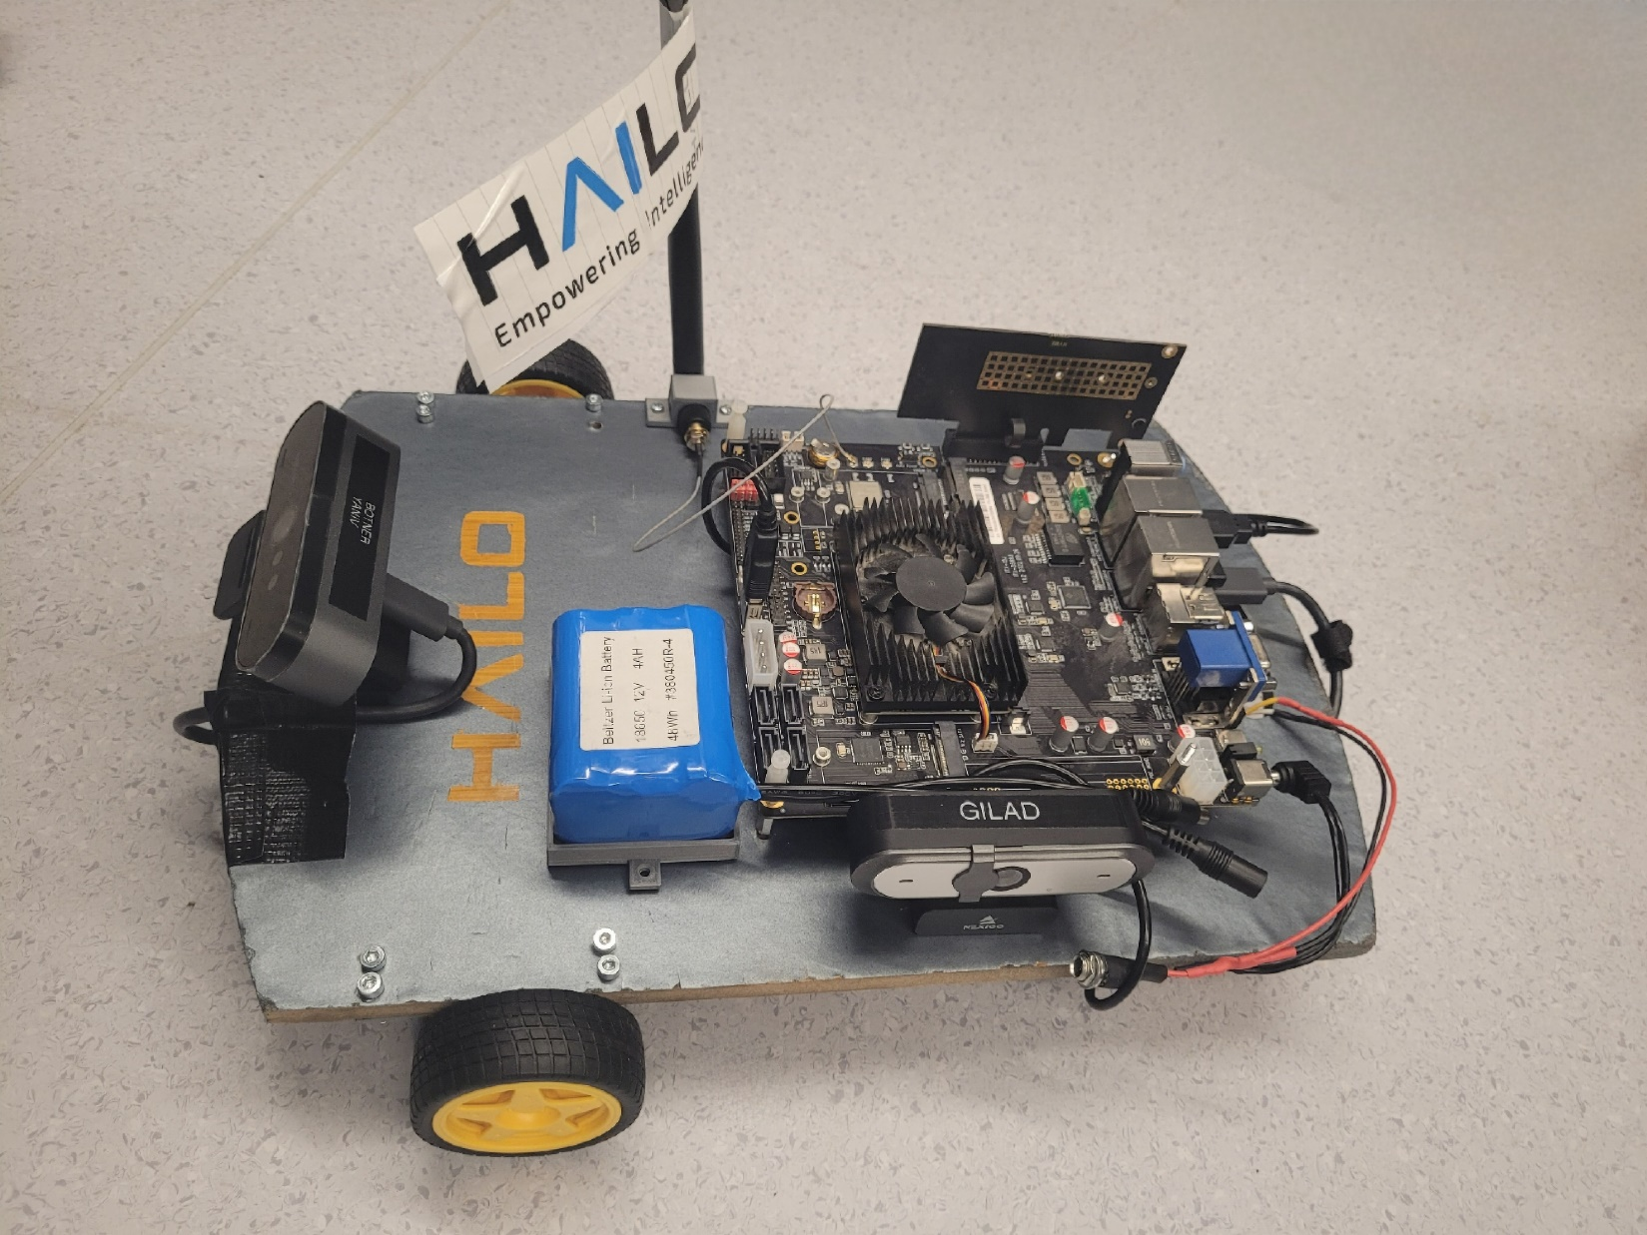


Slide 3
Banana ChAIser
This demo consists of a self-built vehicle that chases a banana
using a YOLOv5 network and demonstrates Hailo's abilities.
The banana simulates a gun, and the car chases the banana (gun)
Holder. The cost of the components for this system is less than $200

Slide 4
Possible use cases
Autonomous moving robots
If we switch the model to pose estimation, we can command the car
using gestures, and simulate an AI trolley carrier that chase his owner
Automotive demo for shows
Another option is to change the model to face recognition, and
use the same trolley use case

Slide 5
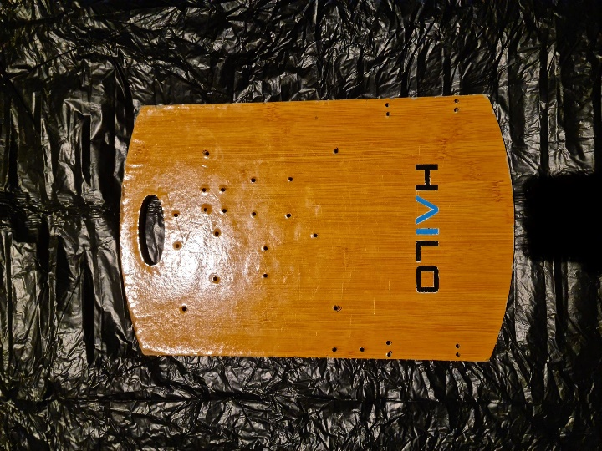
System Components
A wooden bread cutting board (stolen from the 16th floor kitchen)

Slide 6
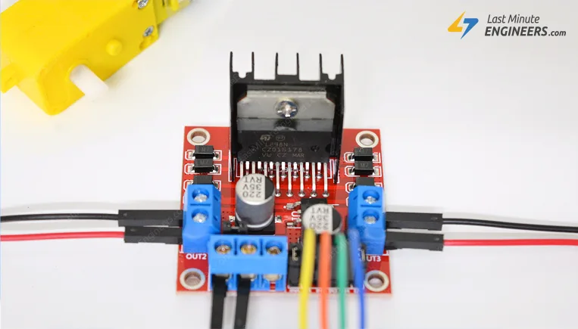
System Components
DC Motor driver module

Slide 7
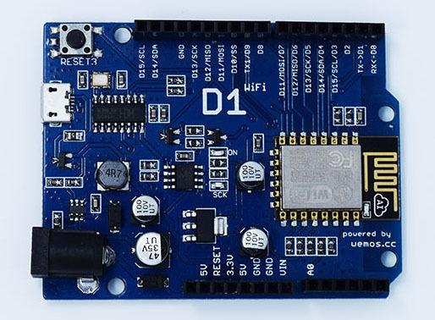
System Components
Wemos D1 Arduino

Slide 8
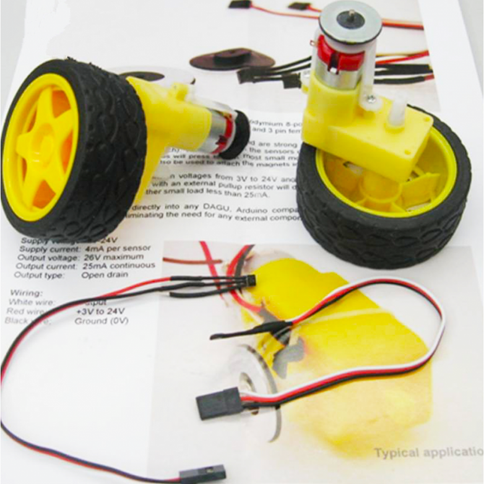
System Components
Simple Motor and Encoder Kit

Slide 9
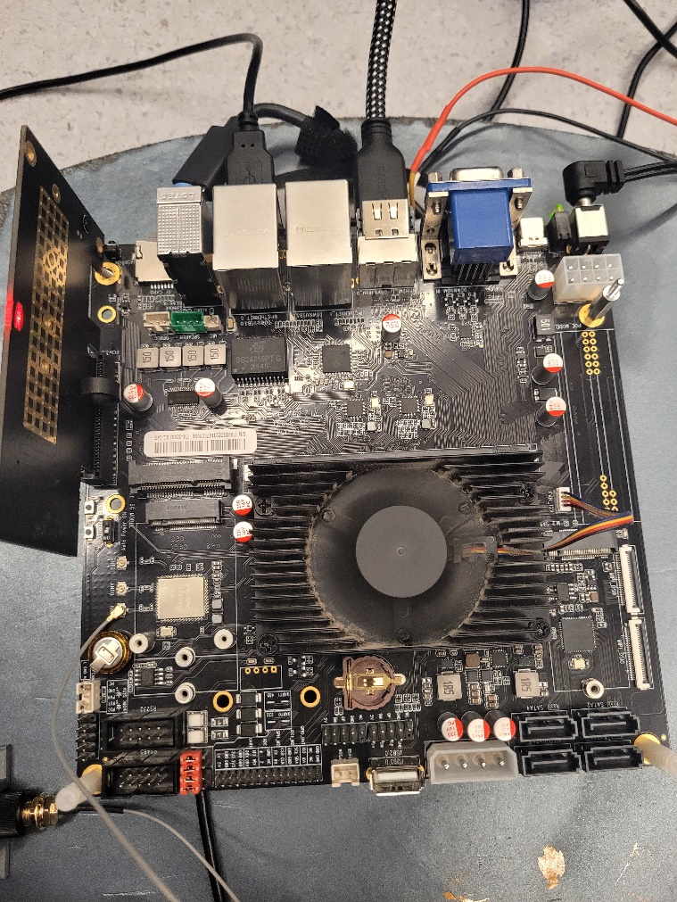
System Components
Rockchip 3588 board

Slide 10
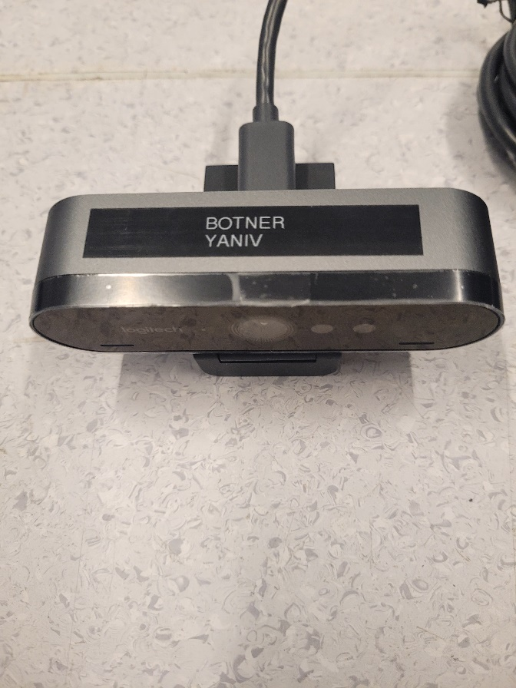
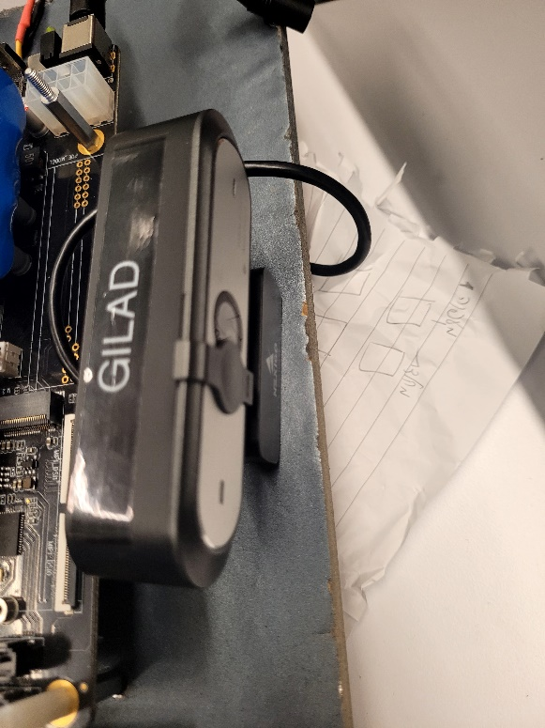
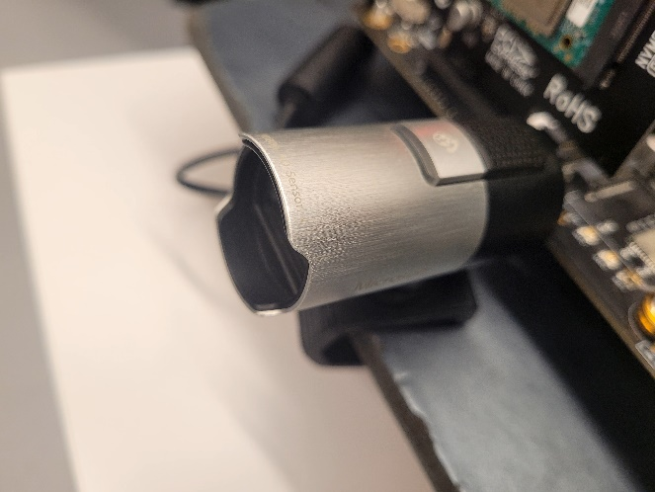
System Components
Yaniv Botner & Gilad’s cameras

Slide 11
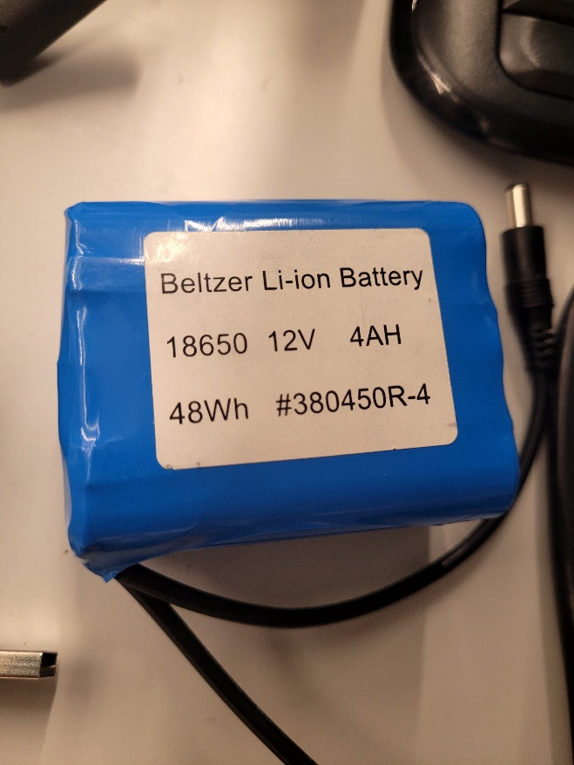
System Components
12V Chargeable Battery

Slide 12
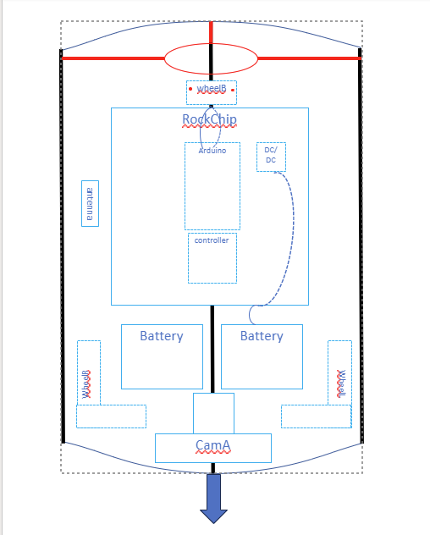
Module Design

Slide 13
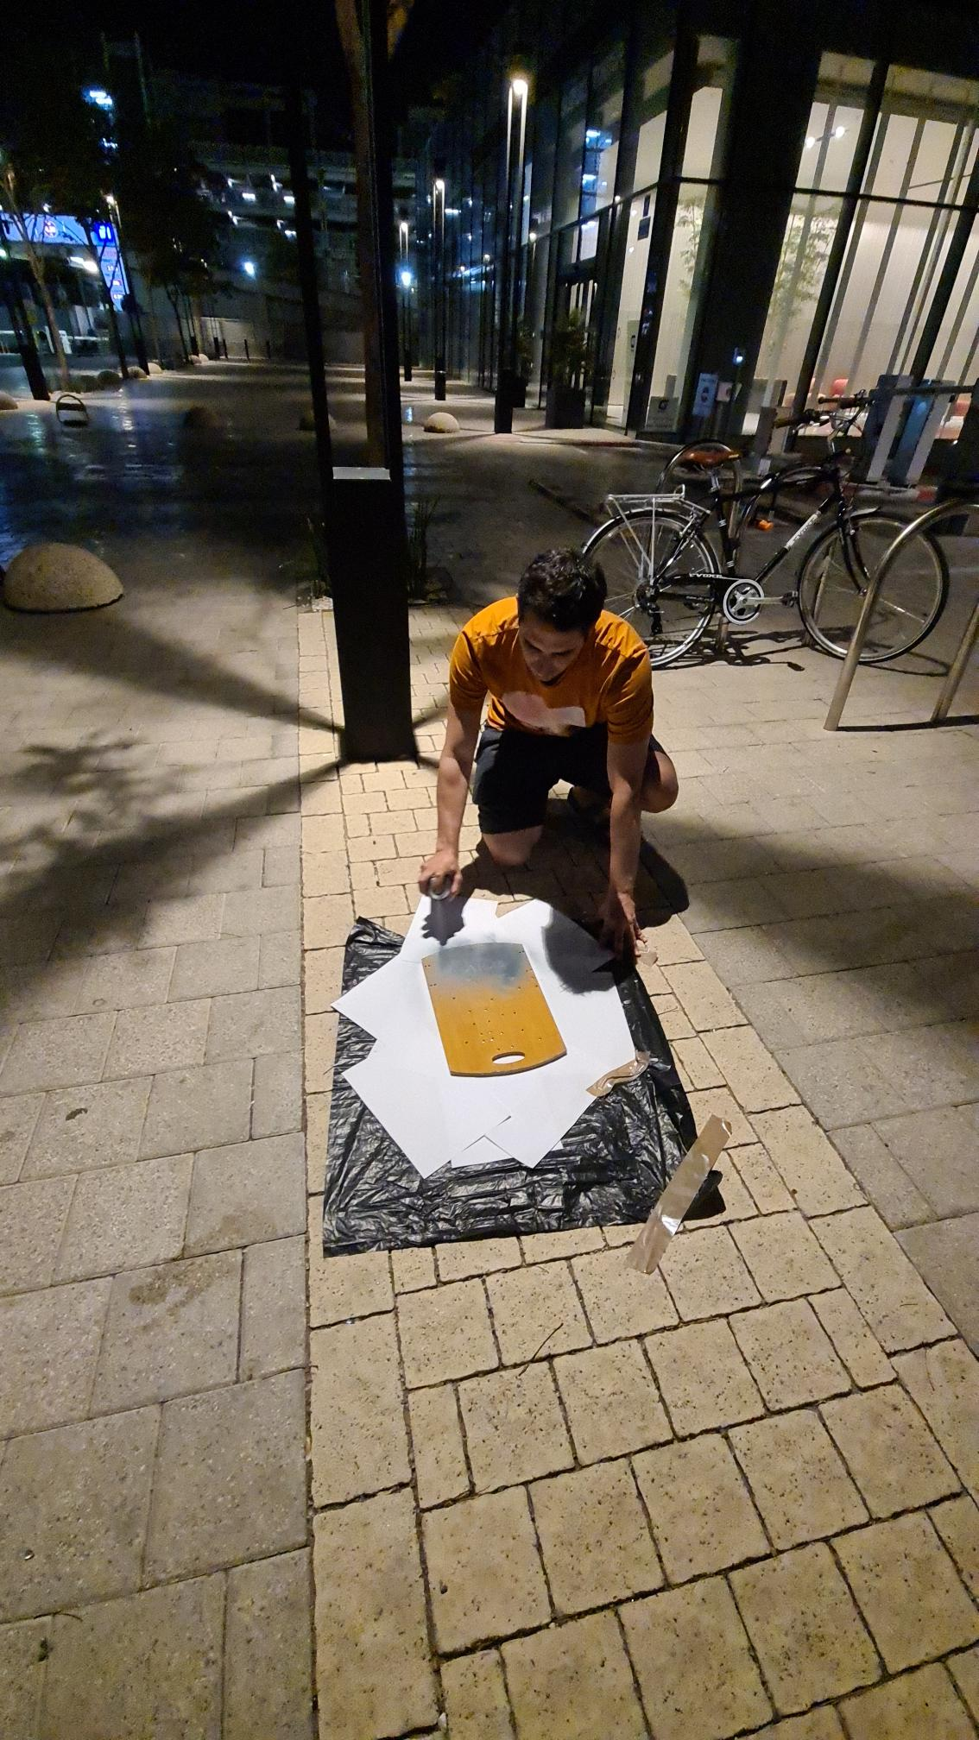
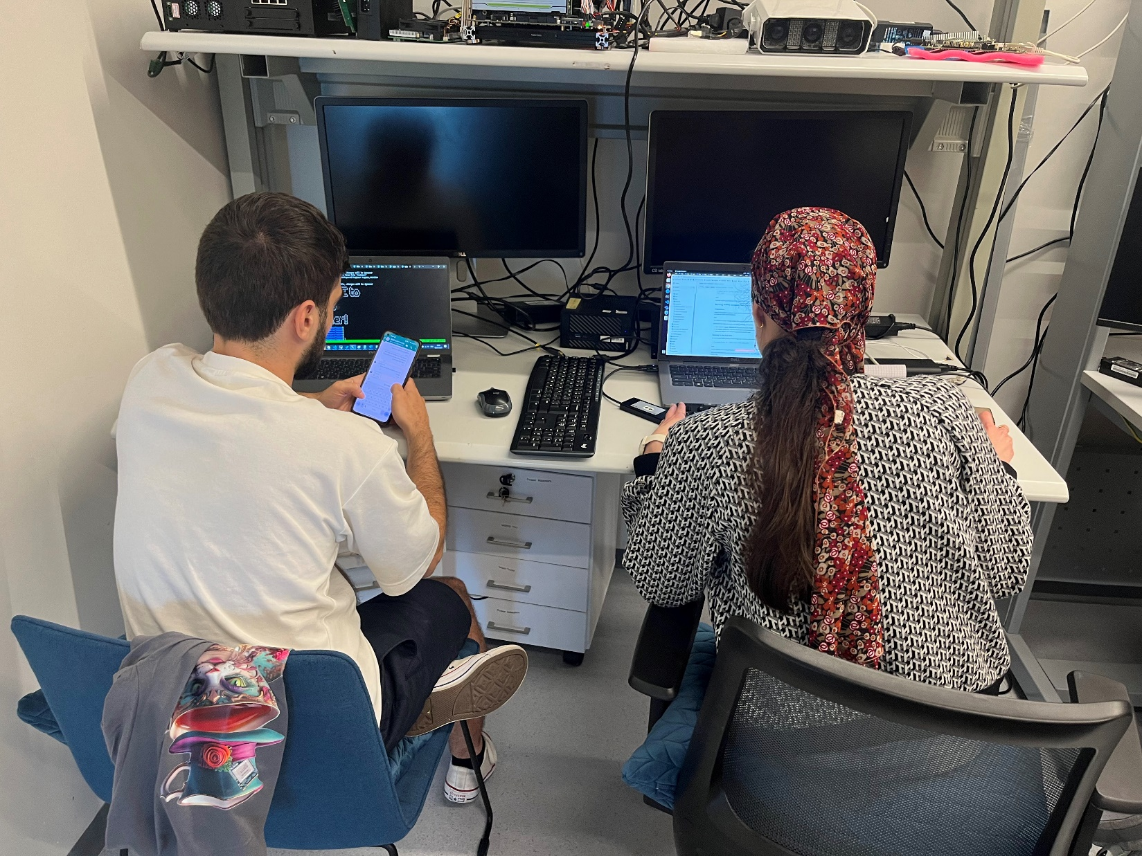
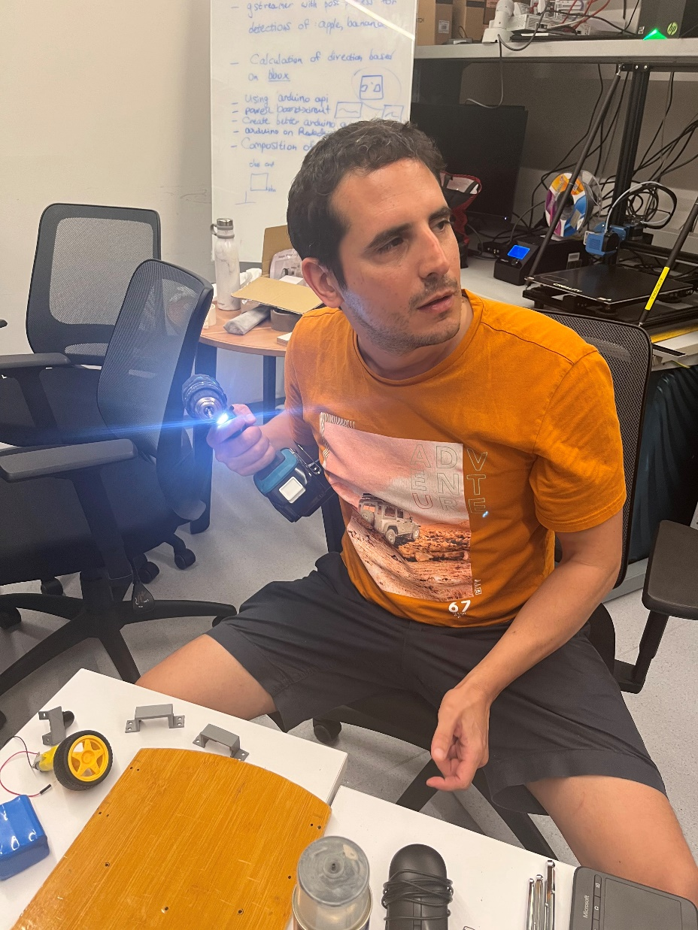
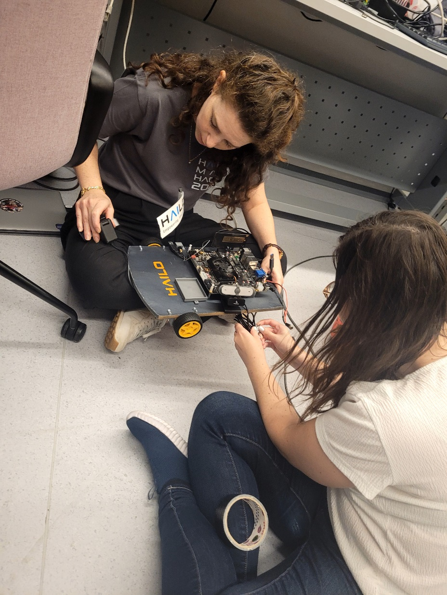
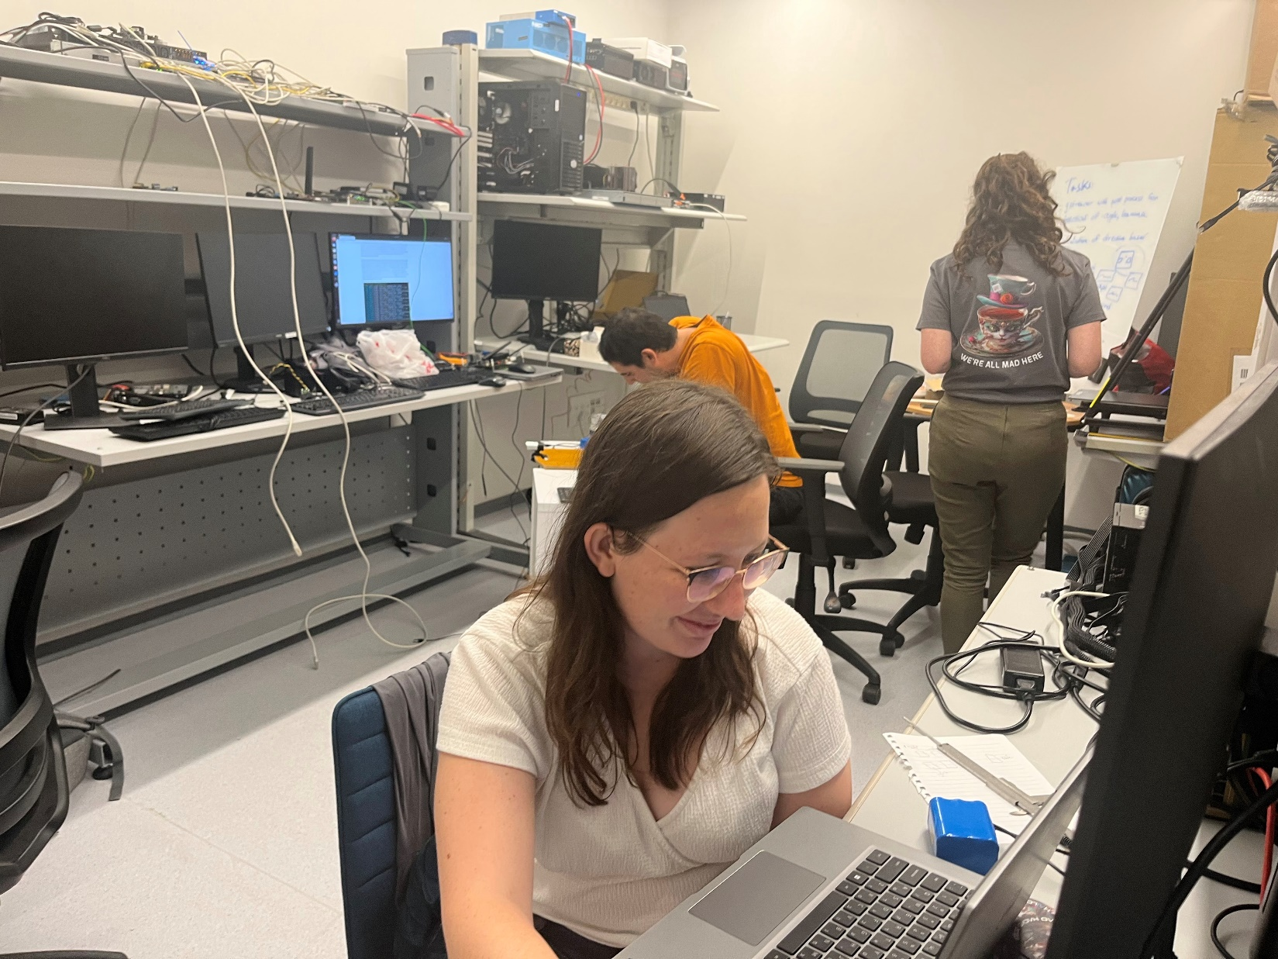
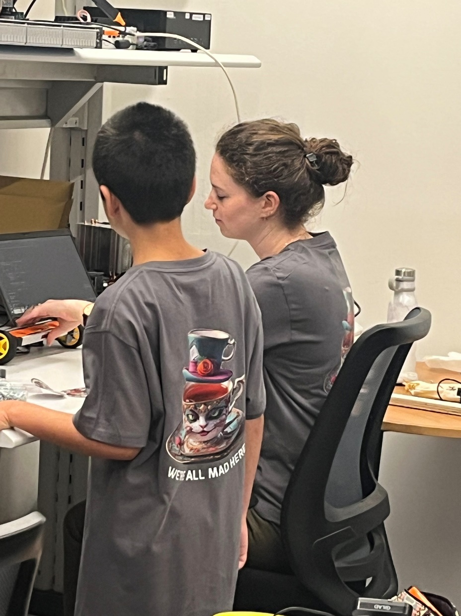
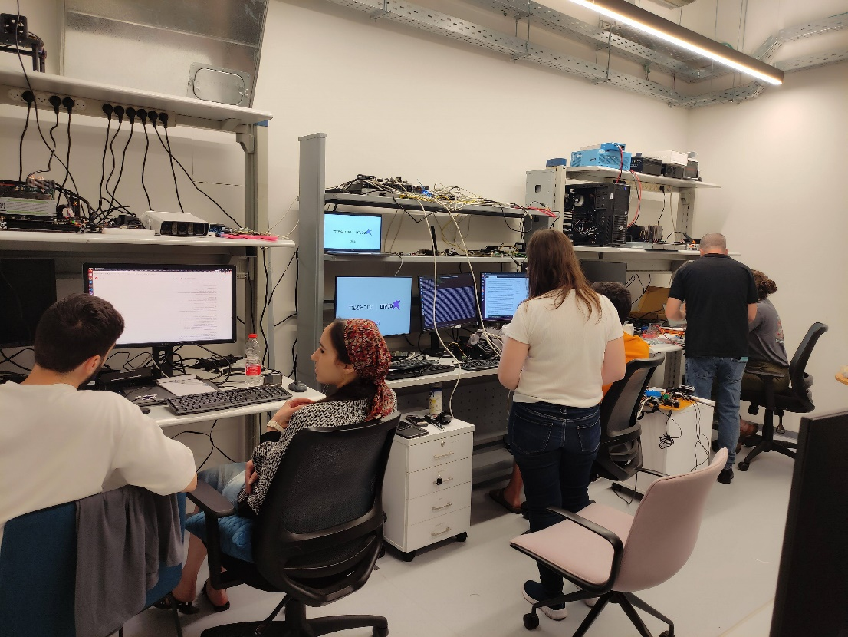
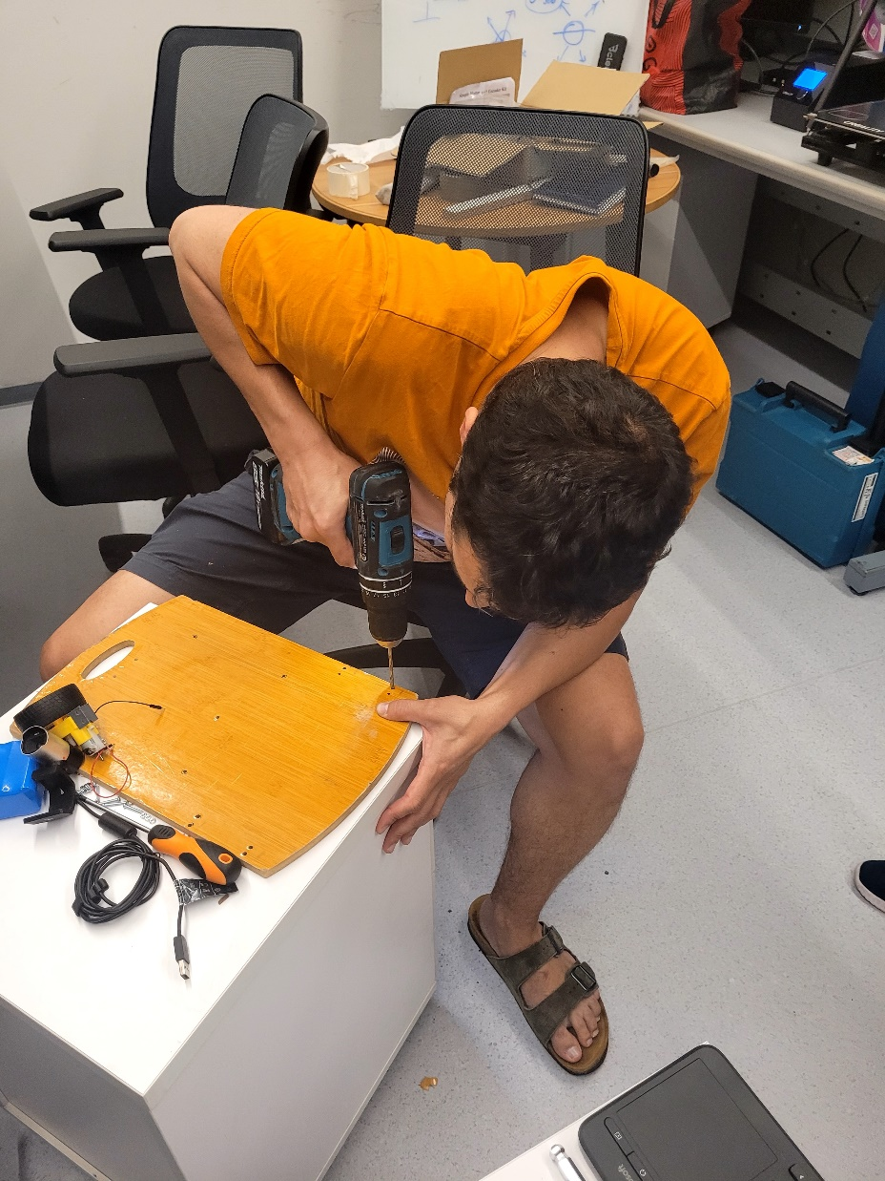
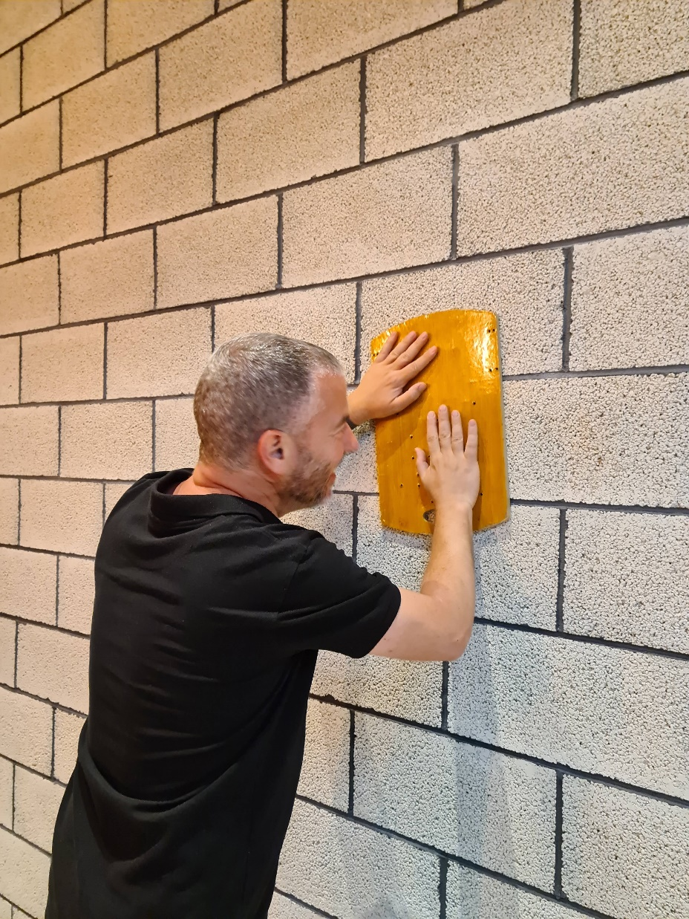
Our Team
Eran Gur – Group Leader
Yasmine Hallel
Dan Hanegbi
Bat-Sheva Knecht
Ronit Shpoliansky
Aviv Harel

Slide 14
It couldn’t happen without…
Yaniv Botner
Svet (for not noticing we stole her wooden cutting board)
Lev Gelerman
Yuval Bernshtein
Alon Cohen
Salomon Paluch

Slide 15
THANK YOU!

